Slide 1


NEWS
AGGREGATOR
Trần Thành Vinh 20225539
Vũ Trung Thành 20220066
Đoàn Anh Vũ 20225465
Nguyễn Mậu Trung 20225534
Lương Hữu Thành 20225458

Slide 2
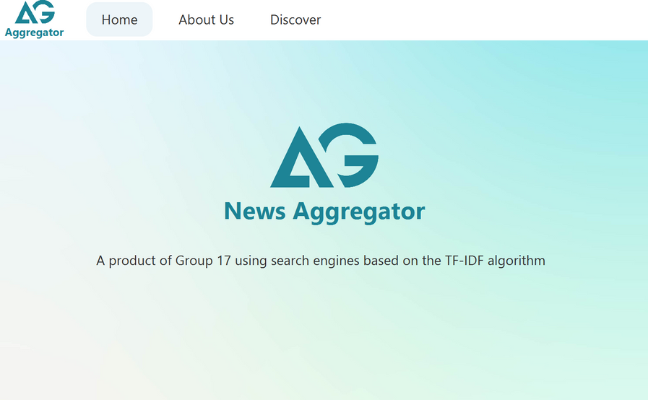

TABLE OF CONTENT
Data analysis
Design
Technical Background
Notable algorithm
Instructions & Demo images

Slide 3

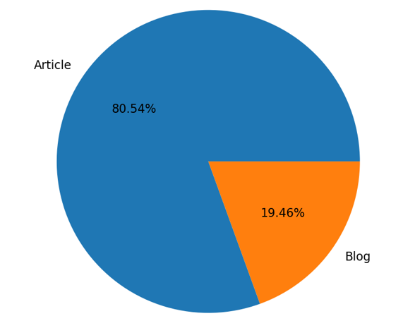

DATA ANALYSIS
Two types of data: Blog, News Article
BLOG: 1803 NEWS
NEWS ARTICLE: 7461 NEWS
4 sources:
CryptoSlate : 2493 news
Cryptonews : 2492 news
Cryptopolitan : 2476 news
Medium : 1803 news

Slide 4
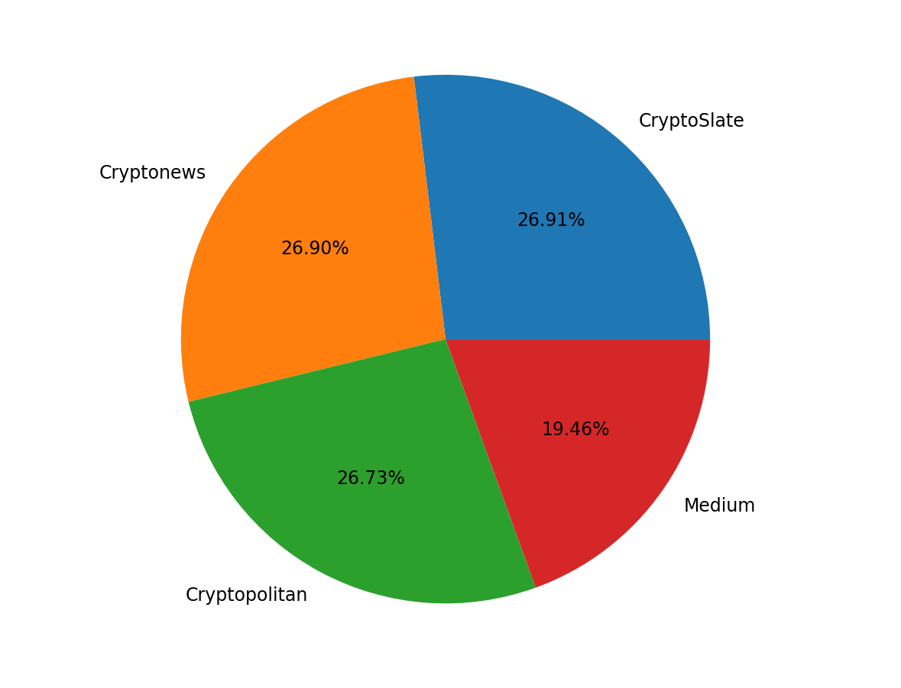




DATA ANALYSIS
Medium
Cryptopolitan
CryptoSlate
Cryptonews

Slide 5

DATA ANALYSIS
Attributes collected to
AUTHOR
CATEGORY
CONTENT
CREATION DATE
LINK
SUMMARY
TAGS
TITLE
TYPE
WEBSITESOURCE

Slide 6


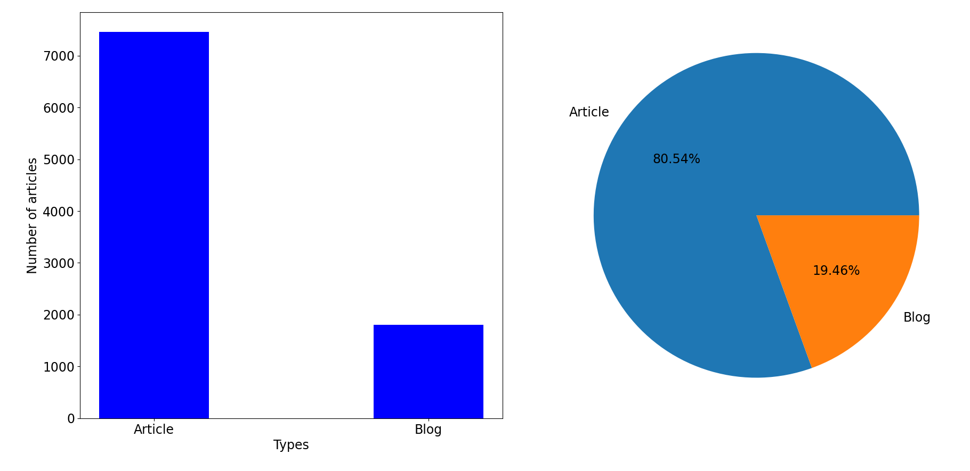
DATA ANALYSIS

Slide 7
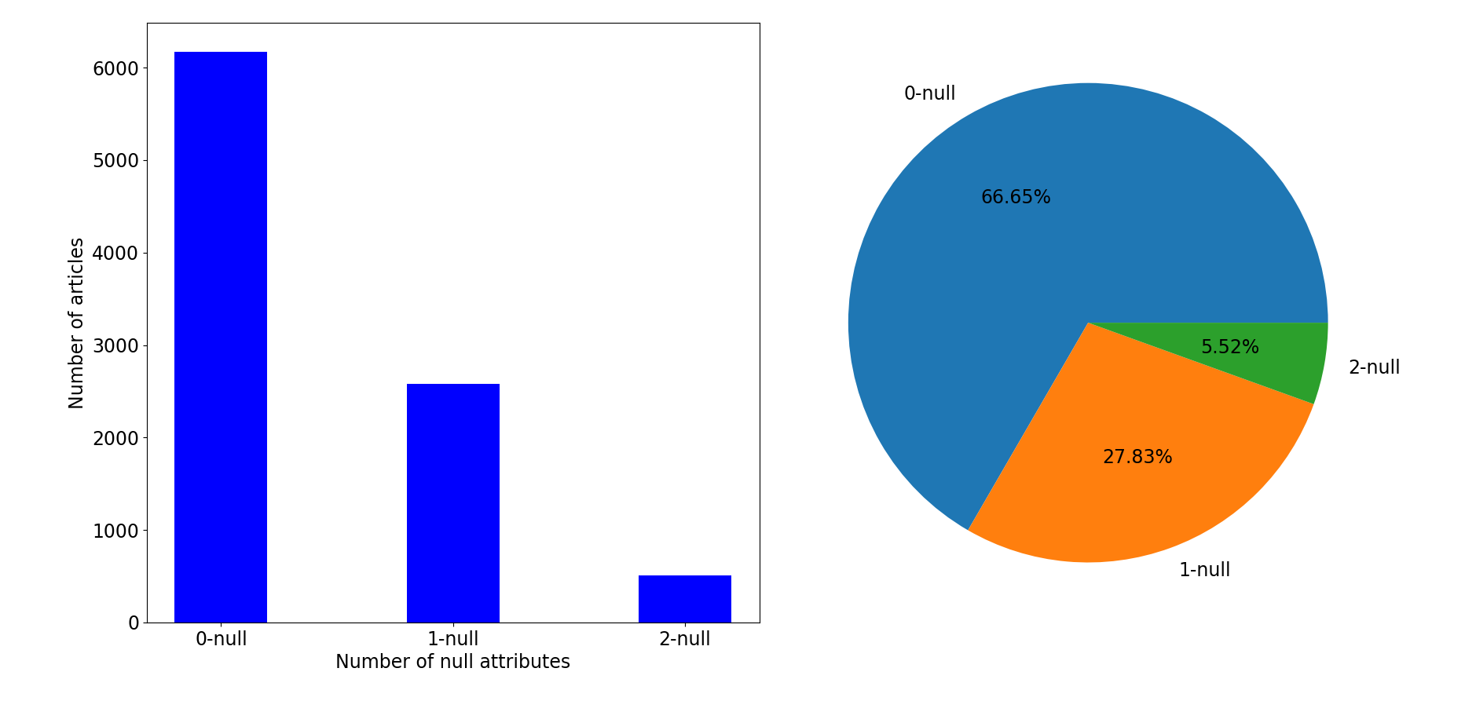
DATA ANALYSIS

Slide 8
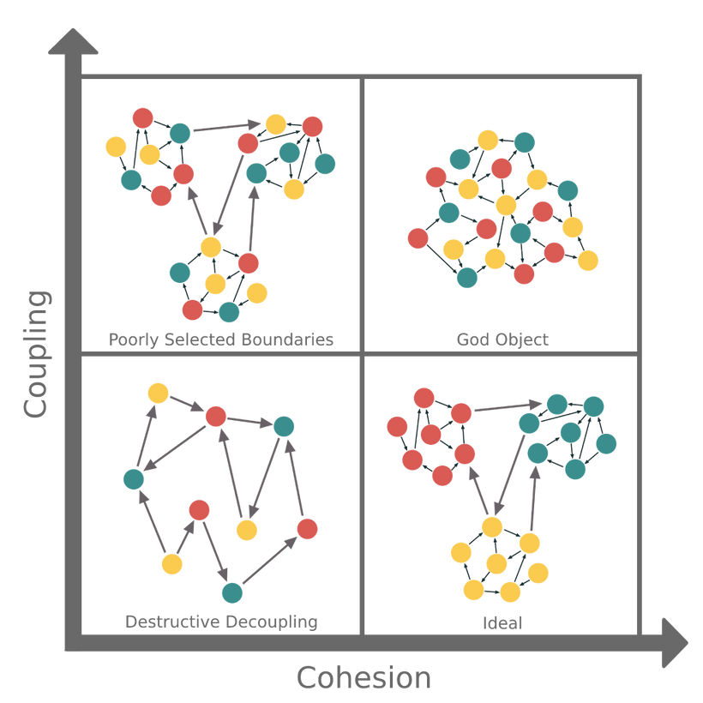
DESIGN
Main principles: High cohesion and Low coupling

Slide 9
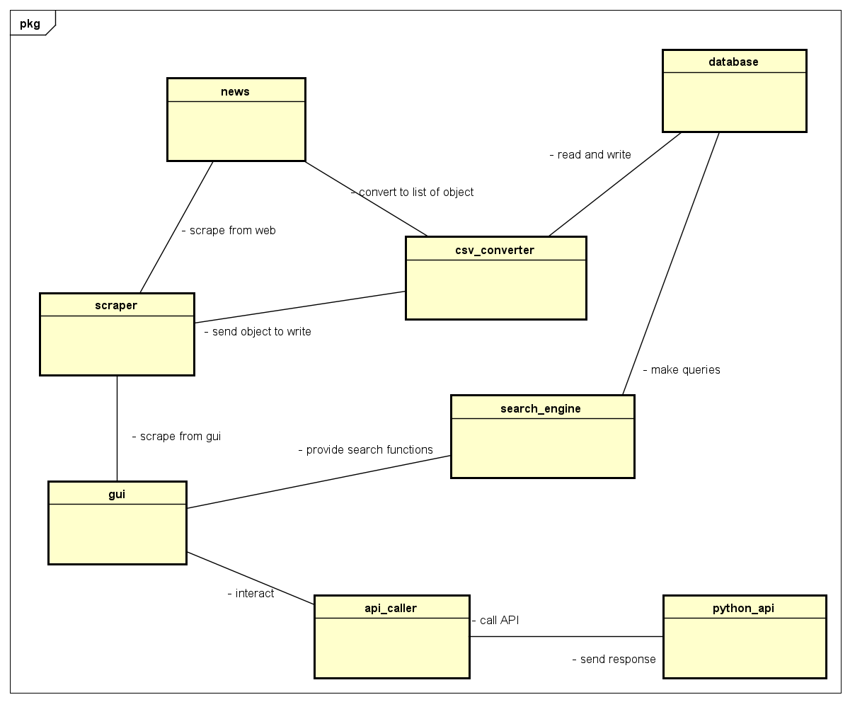
CONCEPTUAL CLASS

Slide 10

OOP TECHNIQUES USED
Abstraction
Polymorphism
OOP
Inheritance
Encapsulation

Slide 11
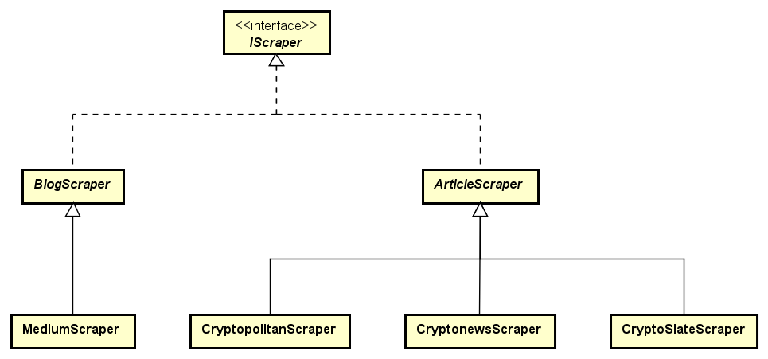
Abstraction
The use of abstract classes in scraper
Developers just need to work with the methods

Slide 12
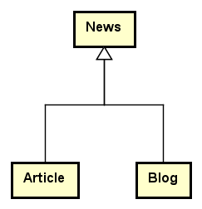
Inheritance
The Blog class and Article class are children of the News class
Inheritance in modelling scrapers

Slide 13
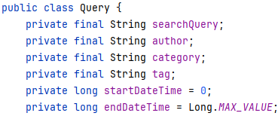
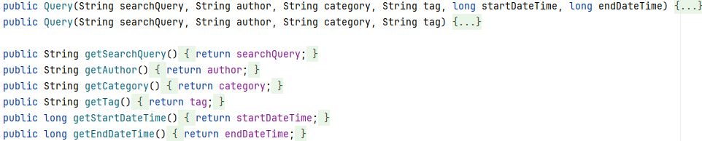
Encapsulation
Every attribute of every class is set to private, and only the getter/setter methods are exposed to other classes.

Slide 14
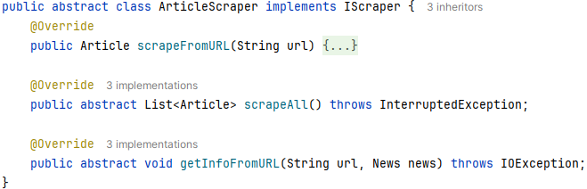
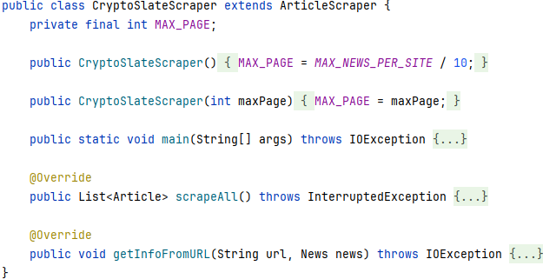
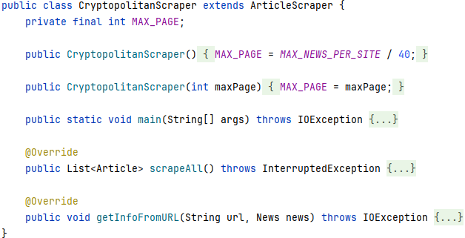
Polymorphism

Slide 15
NOTABLE ALGORITHM
BM25 RANKING ALGORITHM FOR SEARCHING
AUTOCOMPLETE USING TRIE DATA STRUCTURE
TREND DETECTION USING LINEAR REGRESSION
CRYPTOCURRENCY PRICE PREDICTIONS BY SENDING HTTP REQUESTS TO FLASK APPLICATIONS

Slide 16
BM25 RANKING ALGORITHM
BM25 ranking algorithm is based on 4 core concepts:
Term Frequency (TF)
Inverse Document Frequency (IDF)
Document Length
Average Document Length

Slide 17
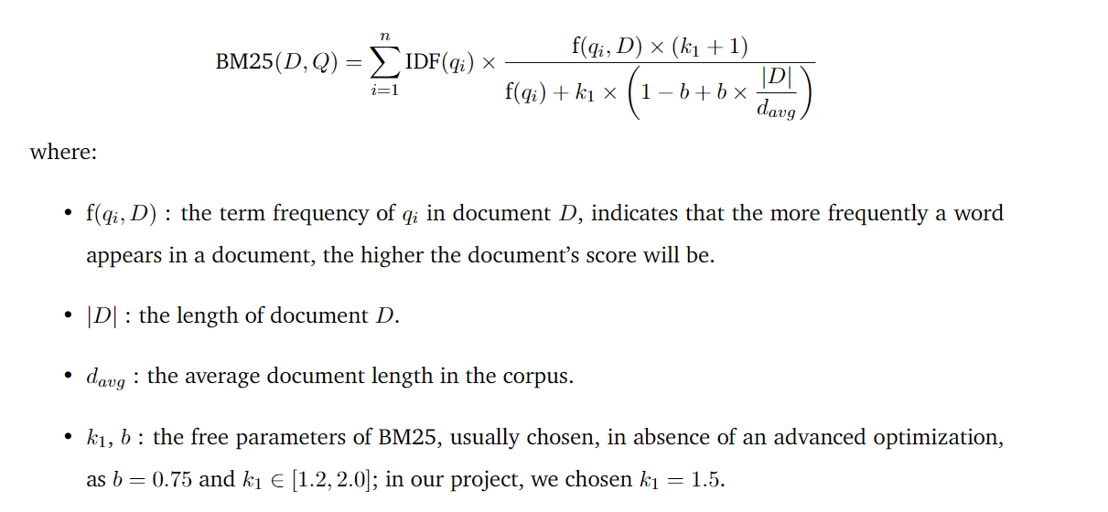
BM25 RANKING ALGORITHM

Slide 18
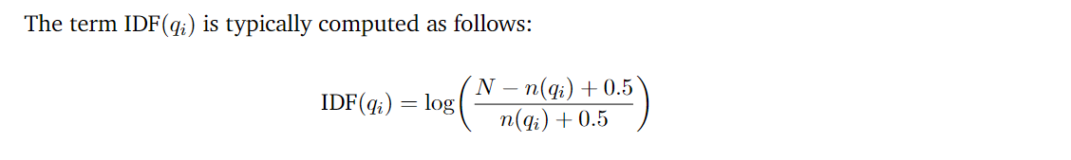
BM25 RANKING ALGORITHM

Slide 19
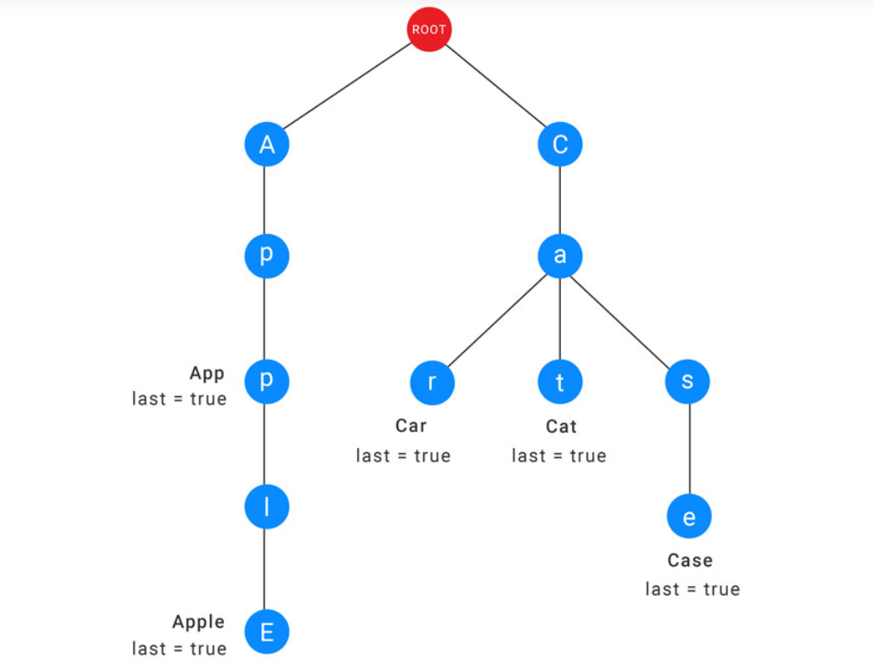
TRIE IN AUTOCOMPLETE

Slide 20
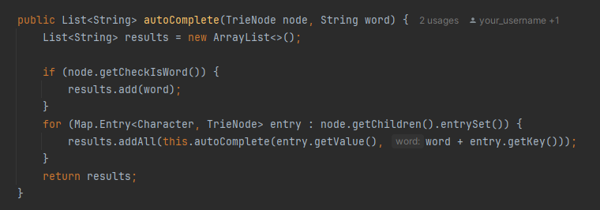
TRIE IN AUTOCOMPLETE

Slide 21
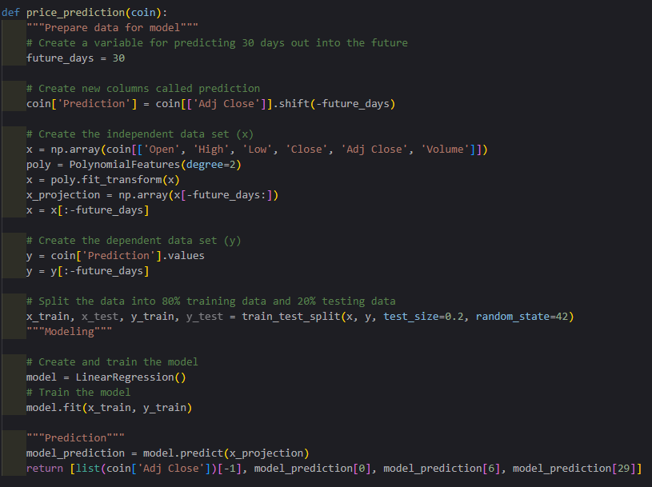
TREND DETECTION

Slide 22
JAVAFX AND SCENE BUILDER FOR GUI

Slide 23

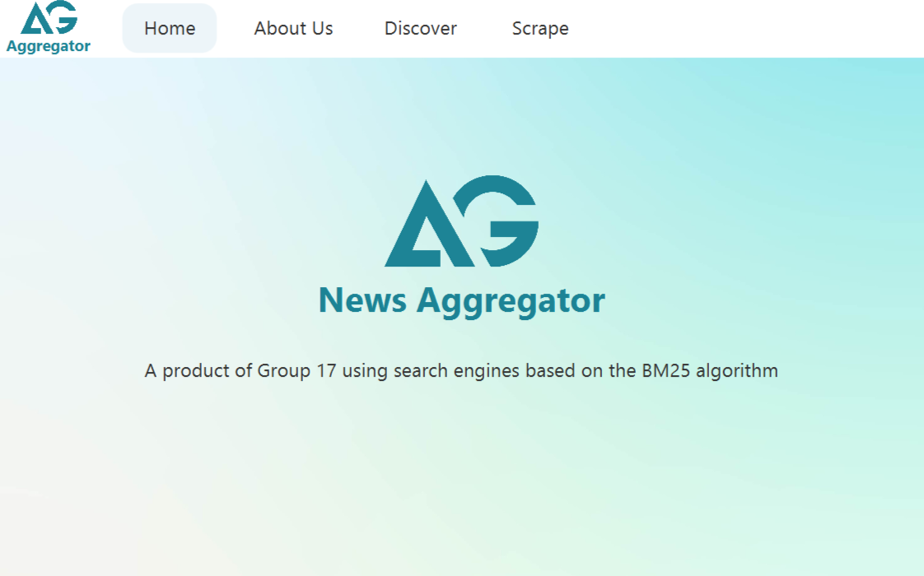

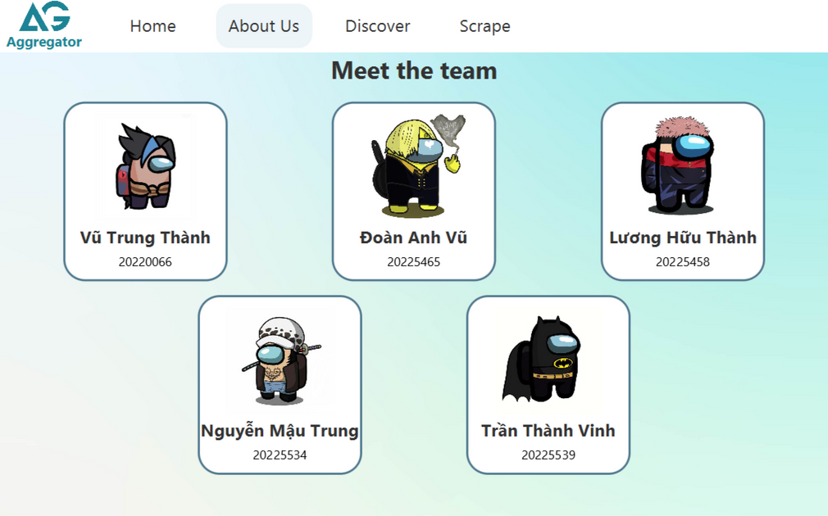
From each scene, we can go back and forth other scenes through buttons

Slide 24
DISCOVER SCENE
DataLoader:
Loaded only once and retrieves all the necessary information for the Discover scene:
Run CSVConverter to get a list of News.
Initialize the SearchEngine, news’image.
Run API to get a list of Predicted Prices.
Load text field and initialize the auto-complete filter method.

Slide 25
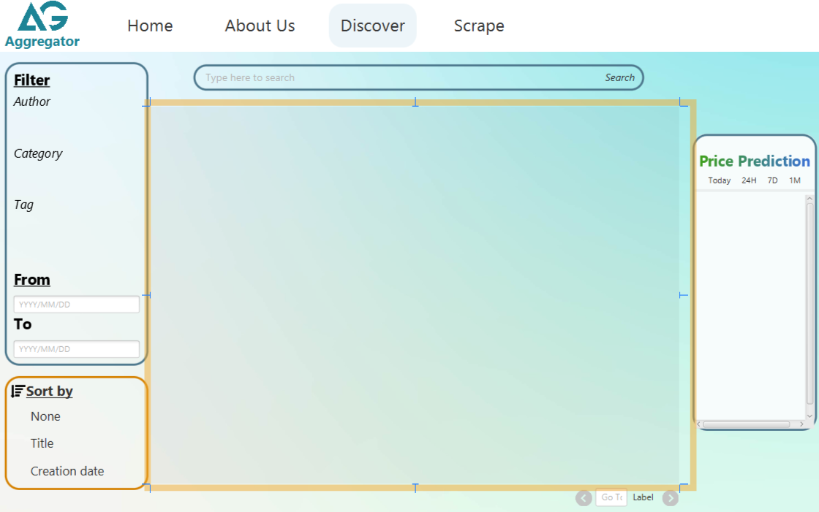

DISCOVER SCENE
News (retrieved from DataLoader) is first attach value through NewsController
Add data (News, Predicted Price) in a VBox inside a ScrollPane.
Get TextField Filter from DataLoader.

Slide 26
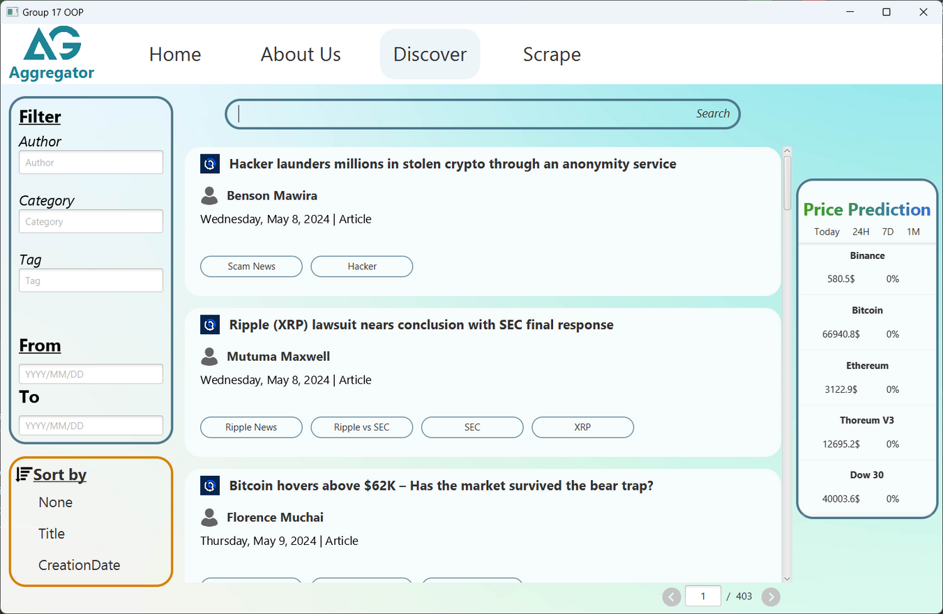
DISCOVER SCENE

Slide 27
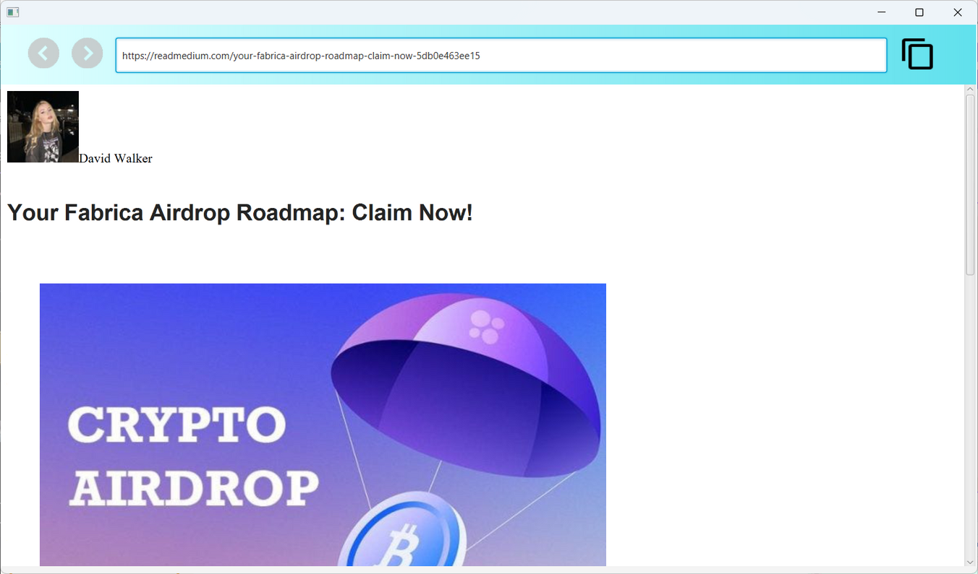
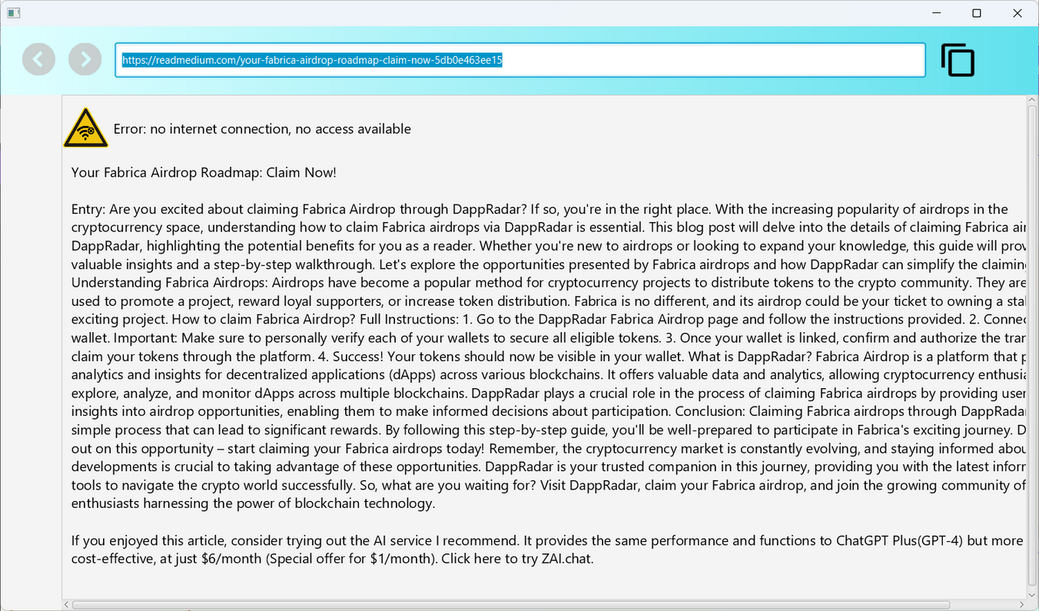
SHOW CONTENT
Online
Offline

Slide 28
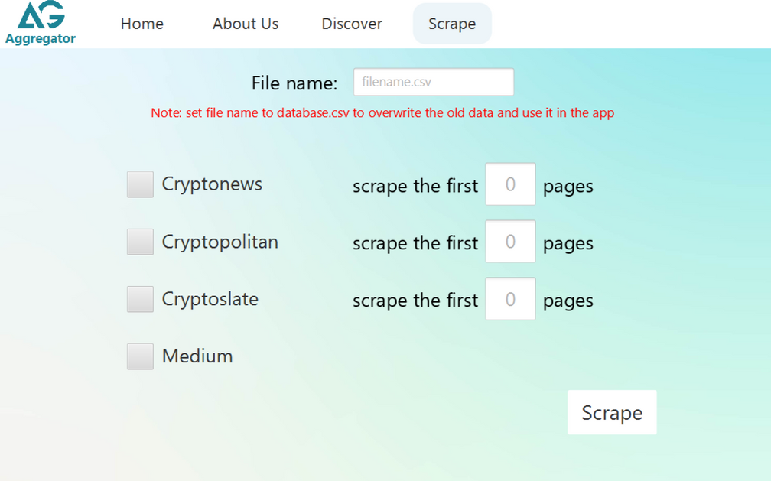
SCRAPE
The checkboxes decide whether the item and number of pages is included in the scraper or not.
The file should be named “database.csv”

Slide 29
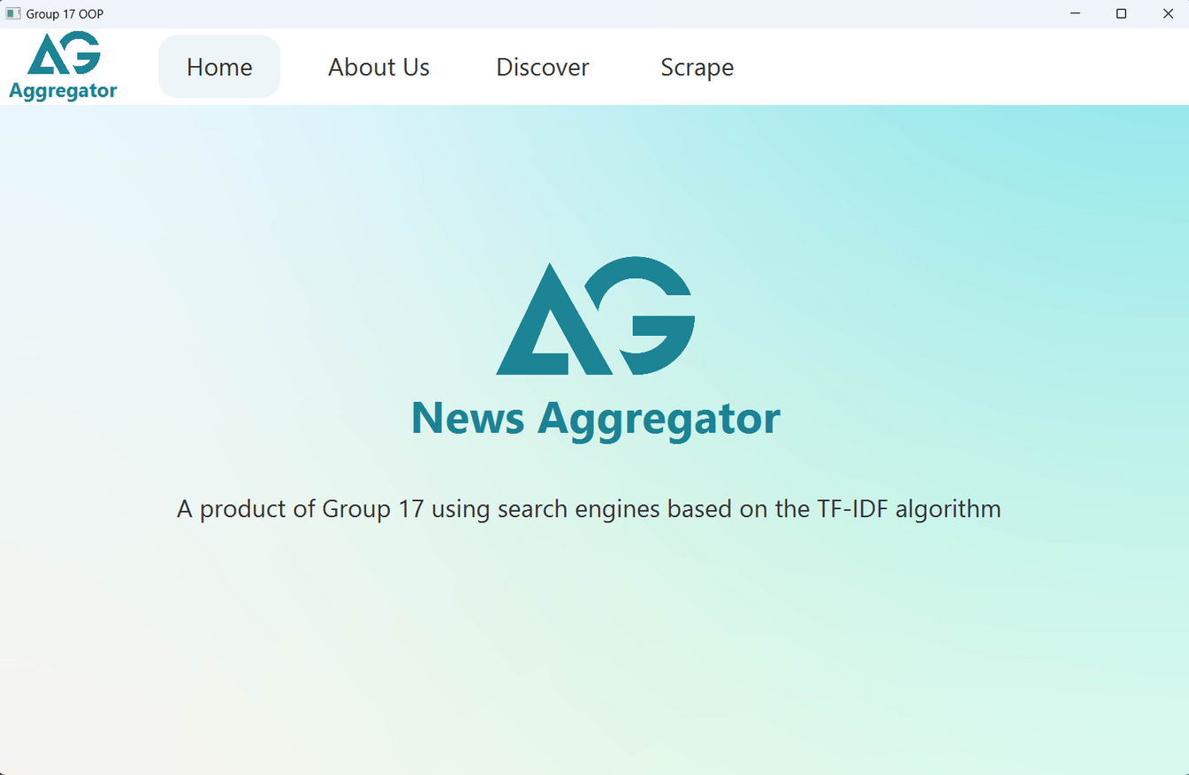

INSTRUCTIONS & DEMO IMAGES
Buttons to move to another scene

Slide 30
INSTRUCTIONS & DEMO IMAGES
Here users can type in search field and then click “Search” or press “Enter” to start searching.

Slide 31
INSTRUCTIONS & DEMO IMAGES
Our application has filter for Author, Category and Tag

Slide 32

INSTRUCTIONS & DEMO IMAGES
Autocomplete will recommend users in real time for more efficient search

Slide 33
INSTRUCTIONS & DEMO IMAGES
Users should type in format YYYY/MM/DD to filter by CreationDate

Slide 34

INSTRUCTIONS & DEMO IMAGES
These buttons allow users to sort search results in order of title, creationdate or none

Slide 35
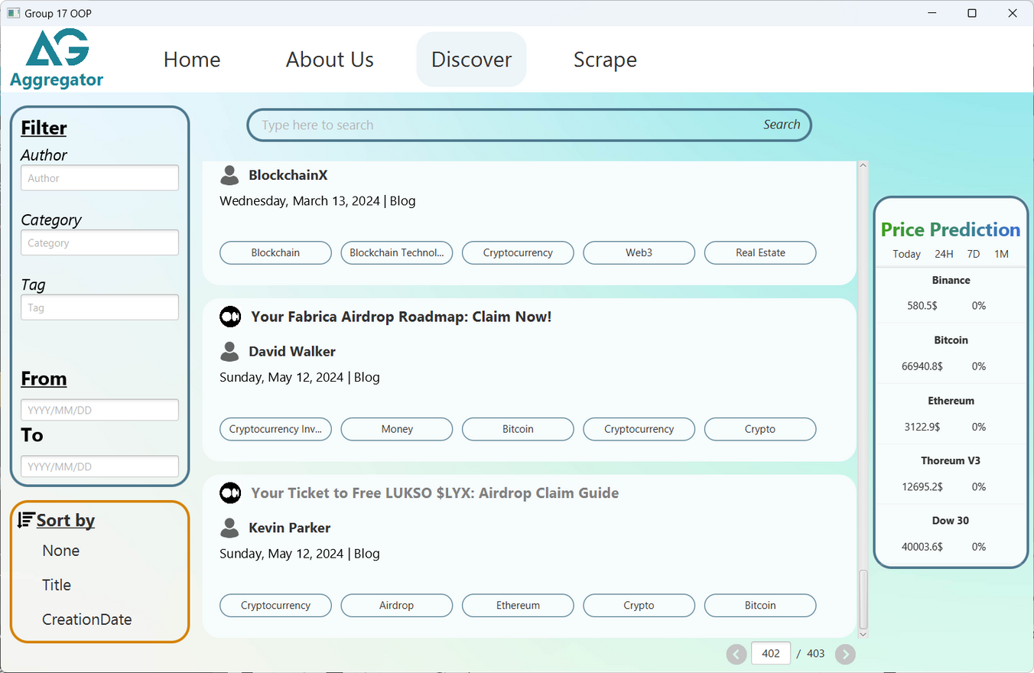
INSTRUCTIONS & DEMO IMAGES
When this title is clicked, it triggers an event to show web (online) or offline content (offline)

Slide 36


INSTRUCTIONS & DEMO IMAGES
Navigation bar contains
Prev, Next button
Link of the article
Copy button

Slide 37
INSTRUCTIONS & DEMO IMAGES
Similar in offline mode

Slide 38

INSTRUCTIONS & DEMO IMAGES
Choices for showing
evolution of value of the coins

Slide 39
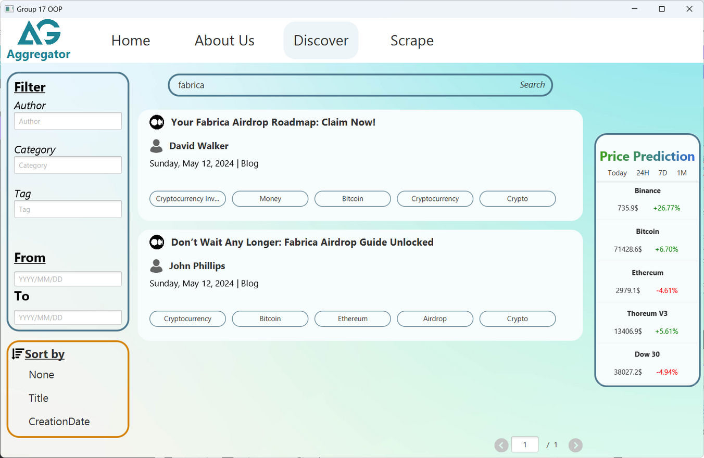

INSTRUCTIONS & DEMO IMAGES
These data show differences in percentages of price predicted in a time interval and the original one.

Slide 40
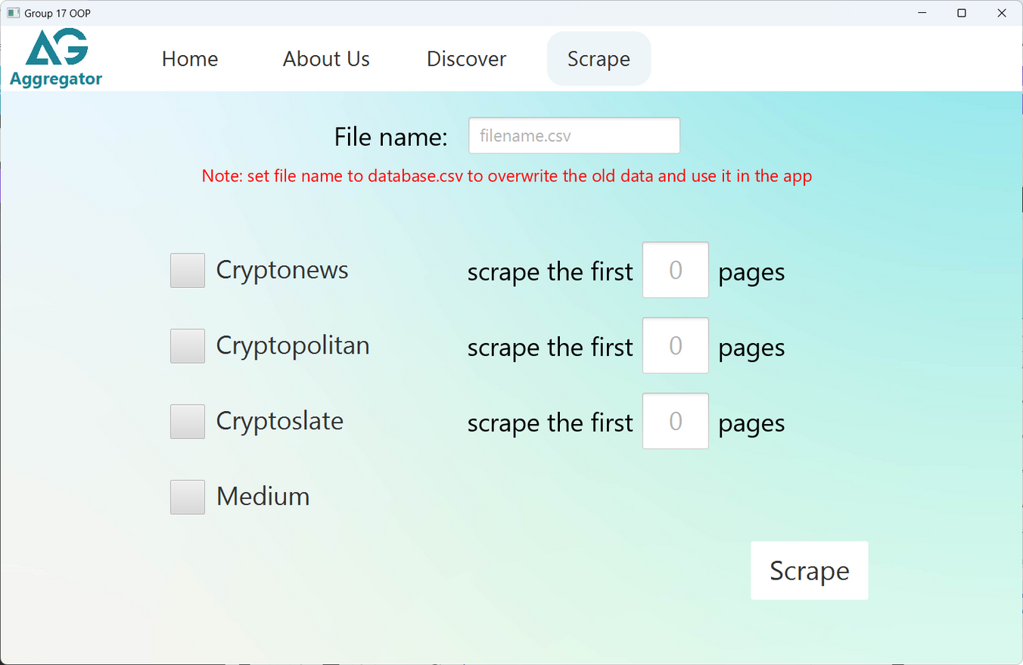
INSTRUCTIONS & DEMO IMAGES

Slide 41
STAY INSPIRED. NEVER STOP CREATING.
THANKS FOR LISTENING!

